Slide 1
Agenda
Introduction to Angular
Angular Vs Angular Js
Why Angular
Angular Architecture and explanation.
HTTP Service
HTTP Mechanism
Why Obserable
HTTP,Obserable,RXJS
AJAX
Why AJAX
Advantages of AJAX

Slide 2
Angular
Angular is a Javascript framework which allow you to create reactive single page applications SPA.
A web application that interact with user by dynamically rewritting the current portion of page rather than loading entire new page from a server is called SPA.

Slide 3
Angular vs Angular JS
Angular
Angular JS
It is worked on ts
Angular provide mobile support
The framework upgraded to a better structure, which provides improved performance and speed.
It uses the Command Line Interface (CLI) to reduce the time when creating applications.
It is worked on JS
AngularJS does not provide mobile support
The two-way binding feature ultimately reduces the efforts and time of construction.
The framework relies on third-party tools such as IDE and WebStorm.

Slide 4
Why Angular
Modularity
Consistency
Maintainability
Productivity
Early handling , suggestion of error using typescript
Better Mobile Support
Cross Platform,SPA application
Angular is a component based framework,so component has reusability.

Slide 5
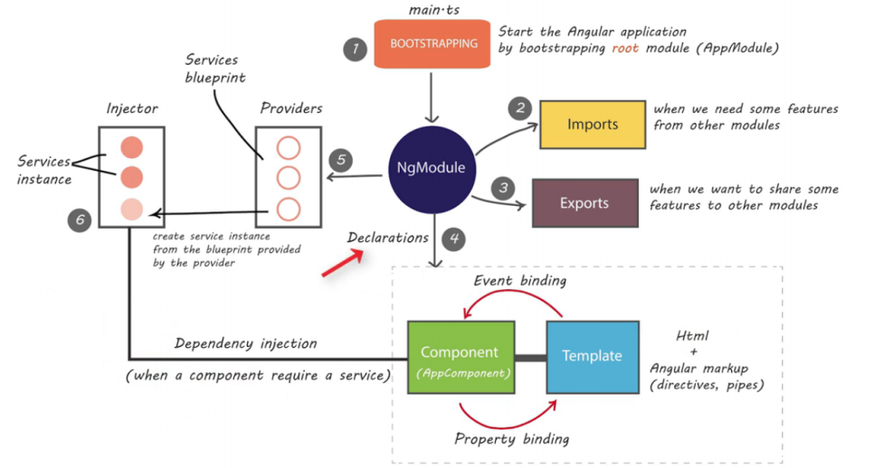
Fig : Angular Architecture
This architecture helps us to flow of execution of angular program

Slide 6
Components in Angular Architecture
Main.ts / Bootstraping:Start the angular application by bootstrapping root module(App Module).
NgModule:An NgModule is a class marked by the @NgModule decorator. @NgModule takes a metadata object that describes how to compile a component's template and how to create an injector at runtime. It identifies the module's own components, directives, and pipes, making some of them public, through the exports property, so that external components can use them. @NgModule can also add service providers to the application dependency injectors.
Imports:When we need some features we will import from other modules.
Exports:When we want to share some features will will exports to other module.

Slide 7
For declaring NgModule we will use:
Eventbinding:Data will send or share from template (UI) to component(controller). Handling to user input events using component class is called event handling. One way Envents supported in angular are enclosed in parenthesis ().Two way events supported in angular are enclosed in banana in the box [()].

Slide 8
Property Binding: Data will send from component to template.{{}}.
Providers: Providers are used to make services. Providers are like a blue print or class.
Injectors: Injectors are service instance like an object. Create service instance from the blueprint provided from the provider.

Slide 9
HTTP Service
Http Service will help us fetch external data, post to it, etc. We need to import the http module to make use of the http service.

Slide 10
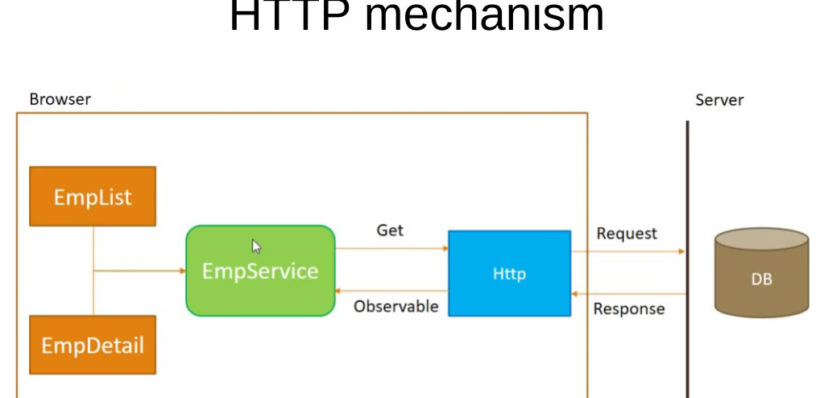
Fig:HTTP Mechanism
Http mechanism consist of two steps: – First step: Send the http request
Second Step: Recieve and process http response

Slide 11
Why Obserable
Obserable is simply http response obtained from REST api
Obserable is not the formate that is used by component, so we need to convert data into employee Array
Data is provided to only component that subscribted to it.
Now it is upto component to display data however they want

Slide 12
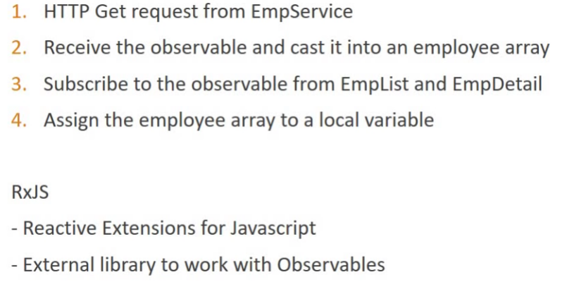
HTTP,Obserable,RXJS

Slide 13
AJAX
AJAX is an Asynchronous JavaScript and XML.

Slide 14
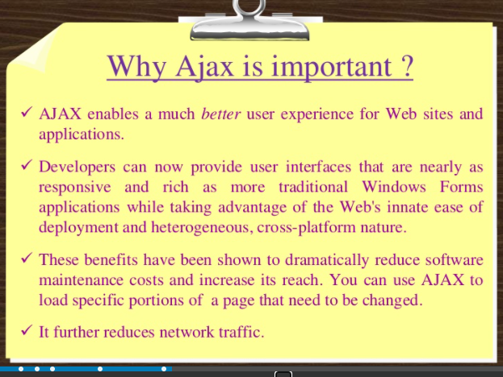
Why AJAX

Slide 15
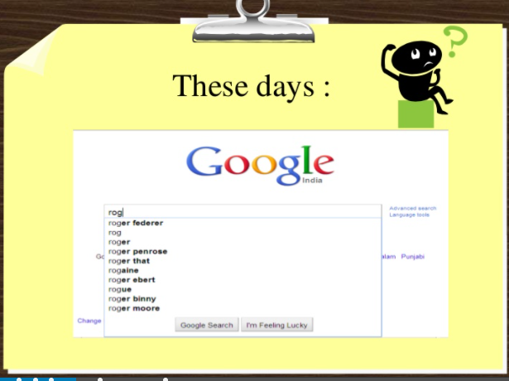
Ajax usage in Google

Slide 16
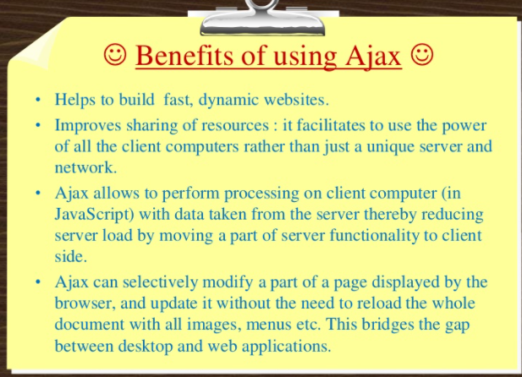
Advantages

Slide 17

Thank You

